Slide 1

TumorTrace
MRI-Based AI for Breast Cancer Detection
NAME: DHANUSH S
ROLE: AI/ML INTERN

Slide 2
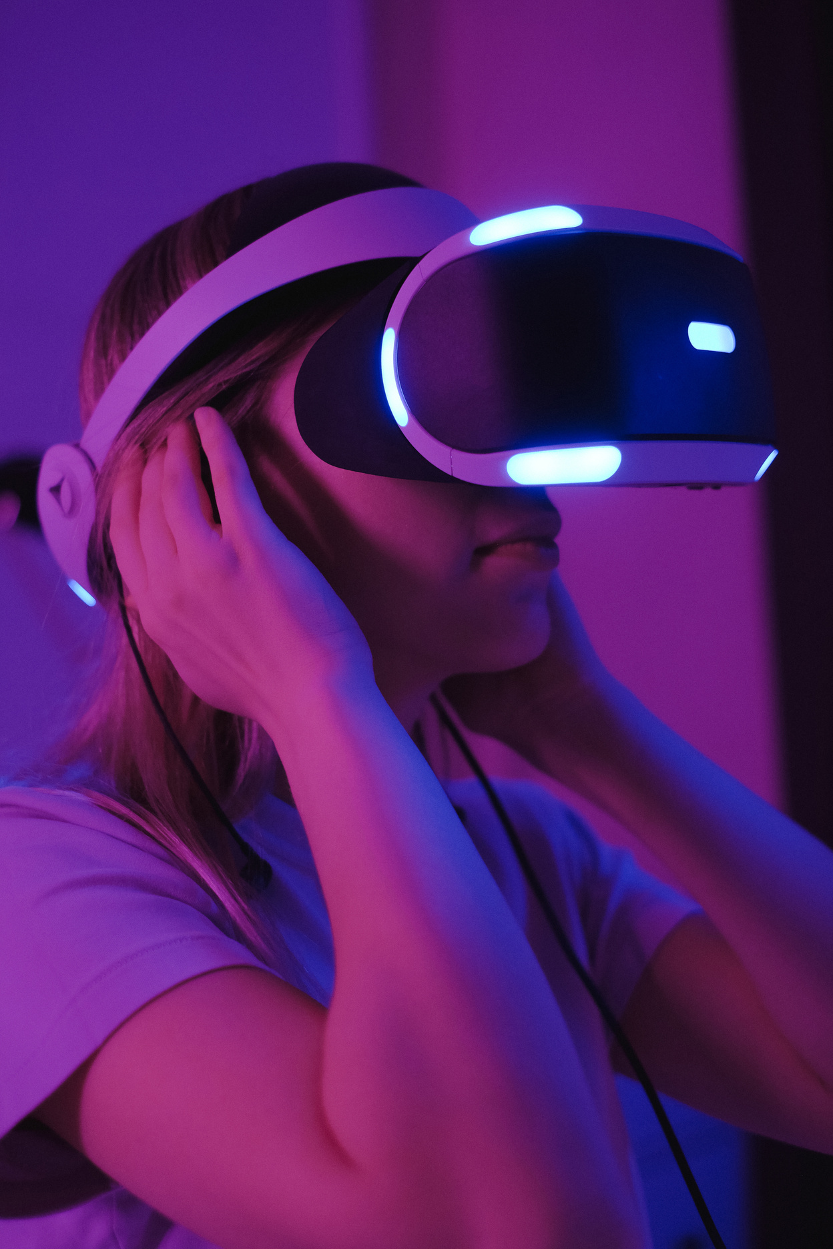
Project Overview
1. Develop a deep learning-based image classification system to differentiate between benign and malignant breast tumors.
2. Optimize the classification model using advanced techniques such as regularization, early stopping, and data preprocessing to enhance accuracy.
3. Evaluate the model's performance on metrics such as training accuracy, validation accuracy, and test accuracy, and identify areas for improvement.
4. Explore the potential of automated tumor classification systems to assist radiologists in clinical decision-making.

Slide 3
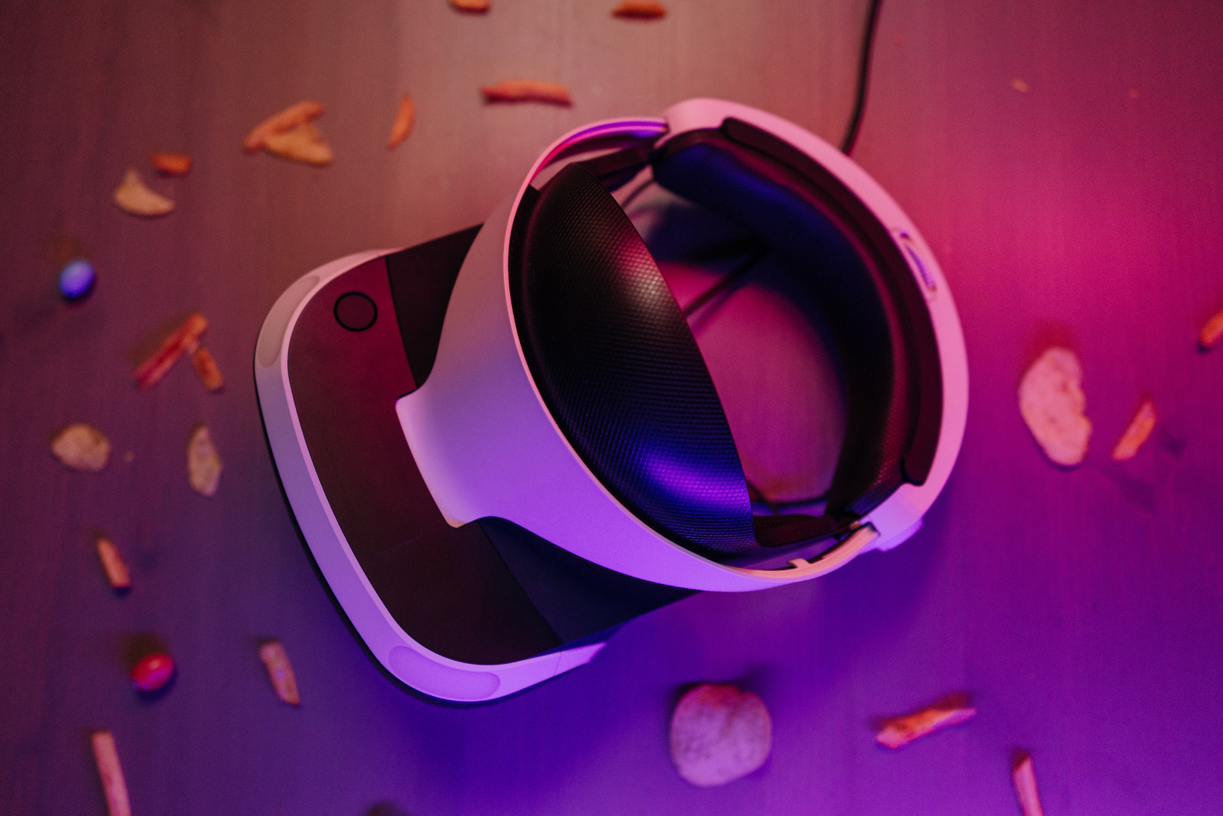
PROBLEM STATEMENT
Service
About Us
Contact
Early Detection Challenge
Delayed diagnosis of breast cancer from MRI scans due to the complexity and time-consuming nature of manual image analysis.
Accuracy Concerns
Variability and errors in traditional diagnostic approaches can lead to missed malignancies or false positives.
AI-Driven Solution
Develop an automated AI system using MRI data to accurately classify tumors as benign or malignant, improving diagnostic speed and reliability.

Slide 4

Dataset Overview
Source of Dataset
The dataset used in this project consists of MRI breast cancer images, categorized into two labels: Benign and Malignant. The images are organized into three subsets: training, validation, and testing, to facilitate the development and evaluation of the classification model.
Source of Dataset : Computers in Biology and Medicine
Structure
Train Set: 20,434 images
Validation Set: 1,989 images
Test Set: 6,851 images

Slide 5
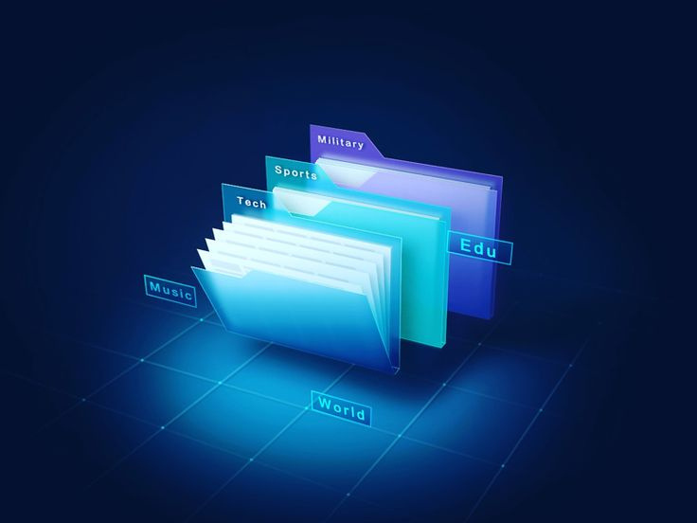
Methodology
Preprocessing
Resizing : All images were resized to a fixed dimension of (224 x 224) pixels to match the input size
Normalization : Pixel values, originally ranging from 0 to 255, were scaled to a range of 0 to 1 by dividing by 255
Mean: [0.485, 0.456, 0.406]
Standard Deviation: [0.229, 0.224, 0.225]
Data Augmentation
Random Horizontal Flip
Random Rotation
Color Jitter
Conversion to Tensor

Slide 6
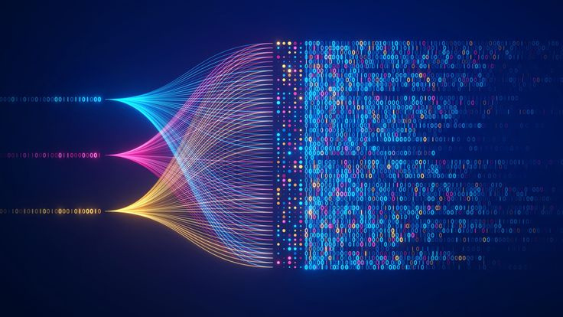
Models Used and Development
Models
•VGG16: A convolutional neural network with 16 layers.
•ResNet18 and ResNet50: Deeper architectures using residual connections for improved training.
Model Selection
The VGG16 architecture is a popular convolutional neural network known for its simplicity and effectiveness in image classification tasks.
ResNet18 & ResNet50: Chosen for better performance in deeper layers with residual learning.
Development Steps
•Initialize pre-trained models.
•customize pre-trained models for the task.
•Train and validate models.

Slide 7

Evaluation Metrics
Accuracy: Percentage of correct predictions.
Precision: Ability of the model to avoid false positives.
Recall: Ability of the model to identify actual positive cases (sensitivity).
F1 Score: Harmonic mean of precision and recall.
AUC (Area Under Curve): Measures how well the model distinguishes between benign and malignant tumors.
Confusion Matrix: Table that helps you understand the performance of your classification. It shows the counts of true positives, true negatives, false positives, and false negatives.

Slide 8
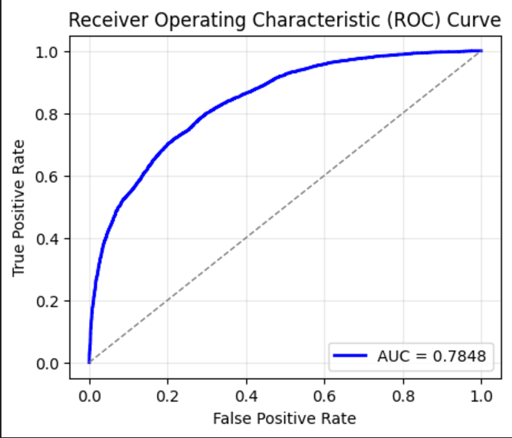
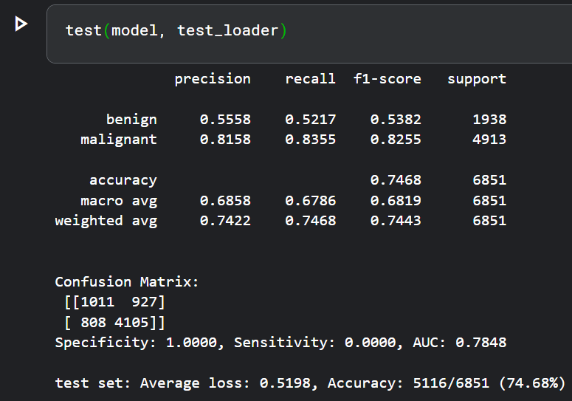
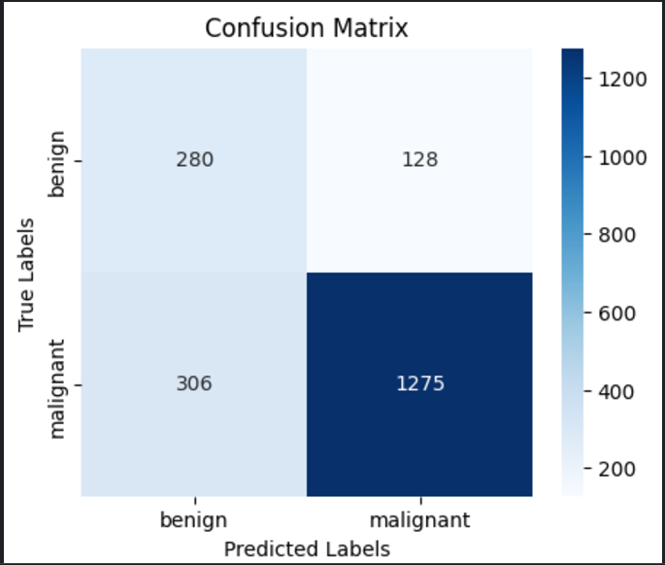
Model Evaluation Results
MODEL 1: VGG16
train accuracy: 83.7%
validation Accuracy: 78.18%
Test Accuracy: 74.68%

Slide 9
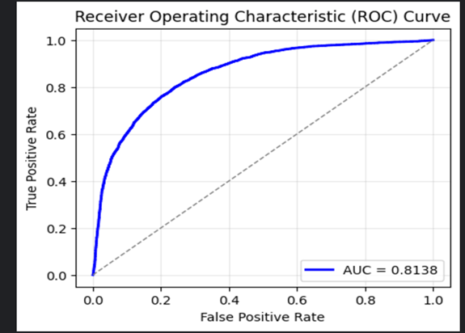
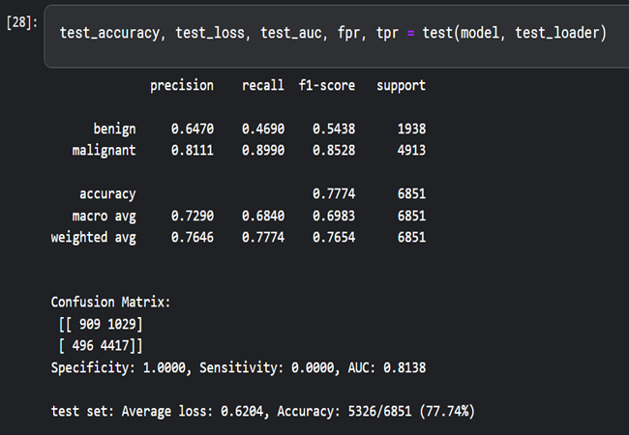
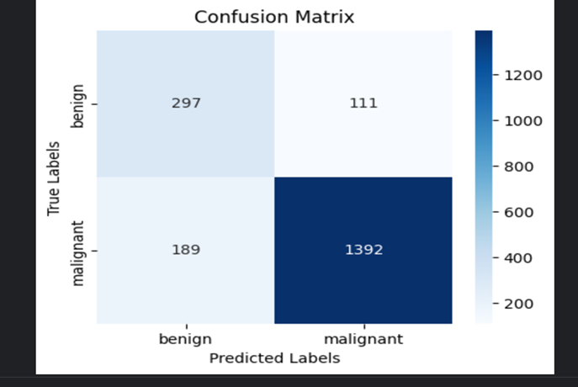
Model Evaluation Results
MODEL 2: RESNET18
train accuracy: : 97.86%
validation Accuracy:84.92 %
Test Accuracy: 77.74%

Slide 10
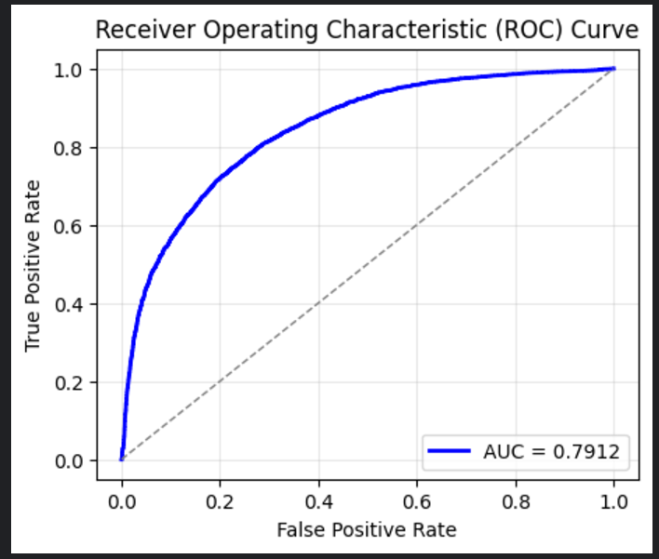
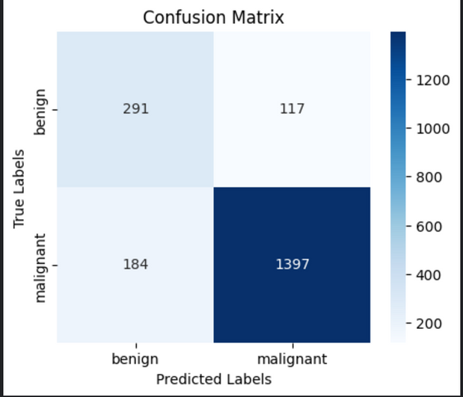
Model Evaluation Results
MODEL 3: RESNET50
train accuracy: : 93.46%
validation Accuracy:84.31%
Test Accuracy: 75.34%

Slide 11
Conclusion
In this project, we explored three deep learning models—VGG16, ResNet18, and ResNet50—for MRI-based breast cancer detection. After evaluating the performance of each model, ResNet18 emerged as the best-performing model, balancing accuracy, efficiency, and generalization. Its relatively lower complexity compared to ResNet50 and faster training time made it an ideal choice for this application, demonstrating its capability to handle the dataset effectively. This work underscores the potential of ResNet18 in real-world medical imaging tasks.

Slide 12
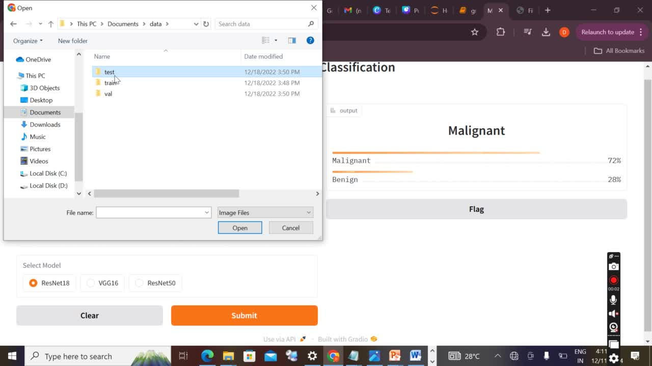
output demo

Slide 13
Thank You

